Slide 1
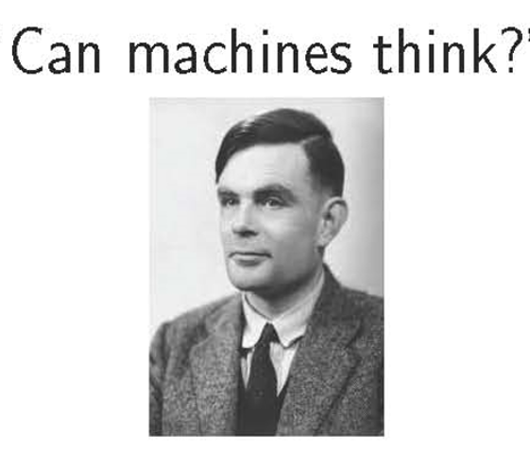

Introduction to Artificial Intelligence
Allen Turing

Slide 2
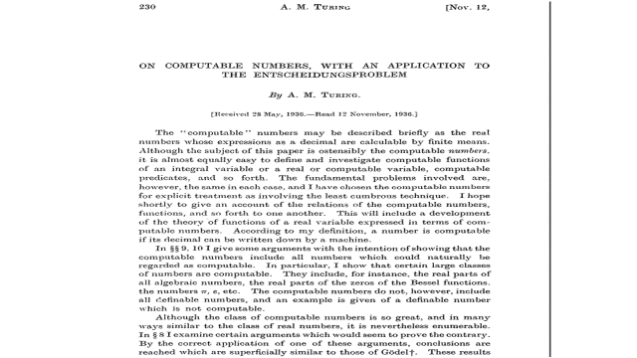

Slide 3
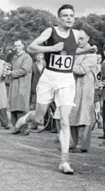
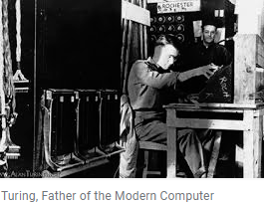
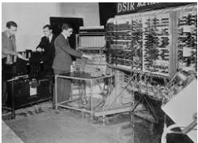
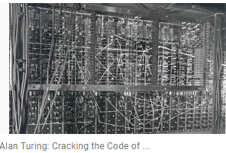
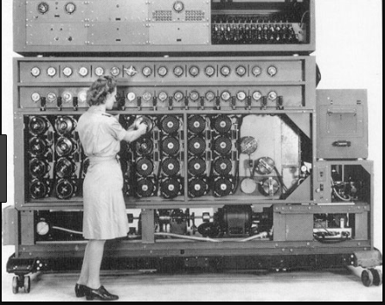
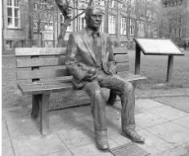

Slide 4
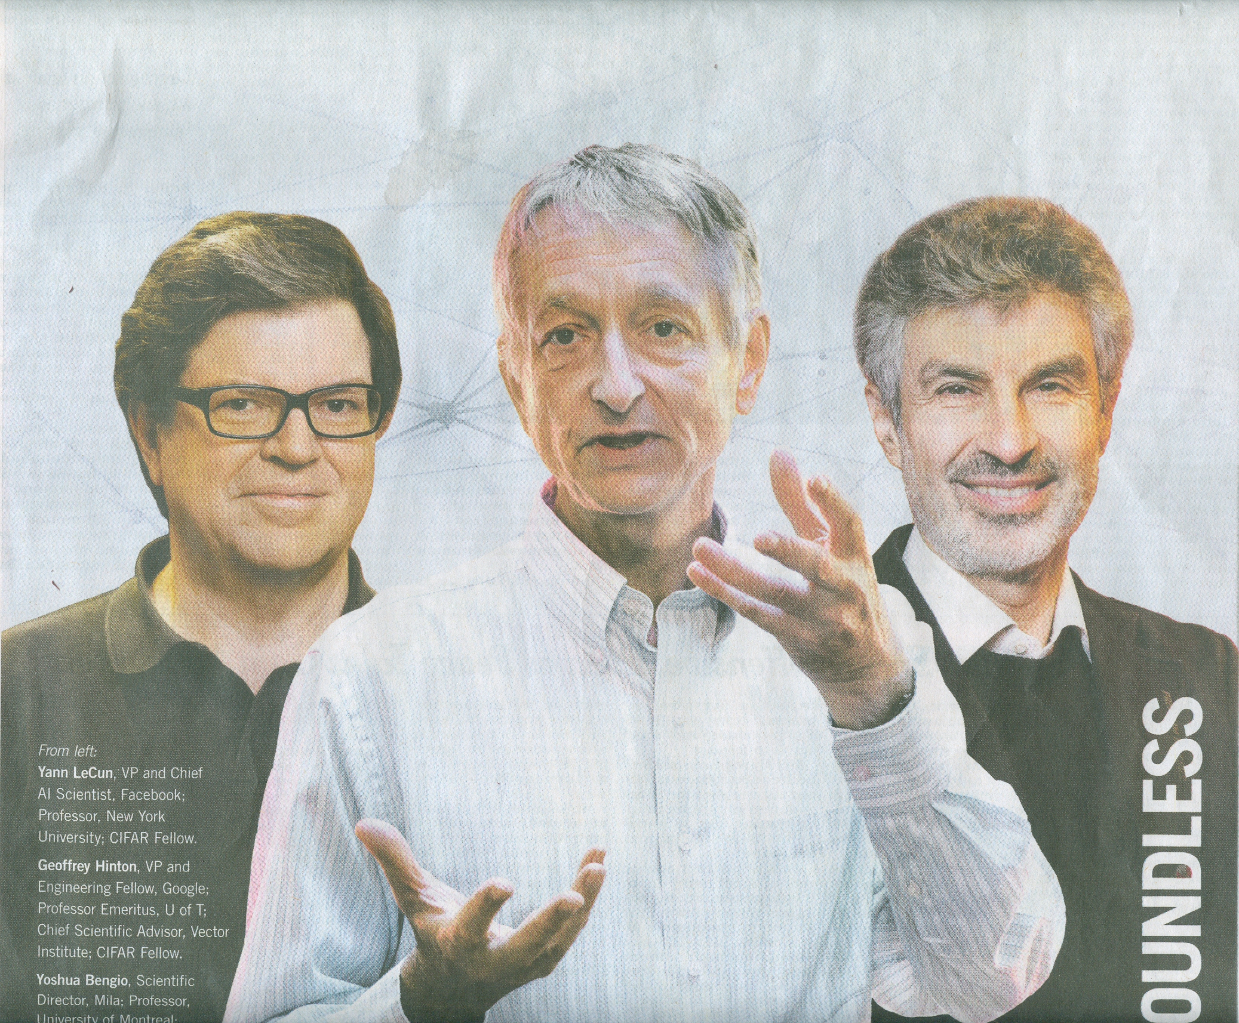
The 2018 ACM A M Turing Award celebrates Yann LeCun, Geoffrey Hinton, and Yoshua Bengio for demonstrating that machines can learn like humans and revolutionizing the field of Artificial Intelligence.

Slide 5


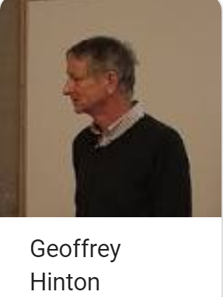

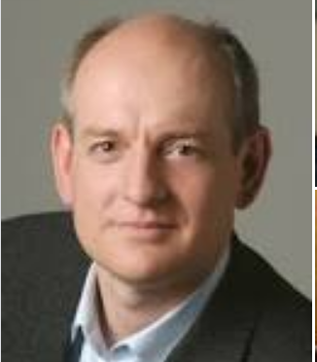


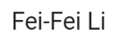





Stuart Russell
Sadi Evren SEKER Marc Ranzato
Vincent Conitzer Dan Klein Peter Abbeel Min-Yen Kan

Slide 6
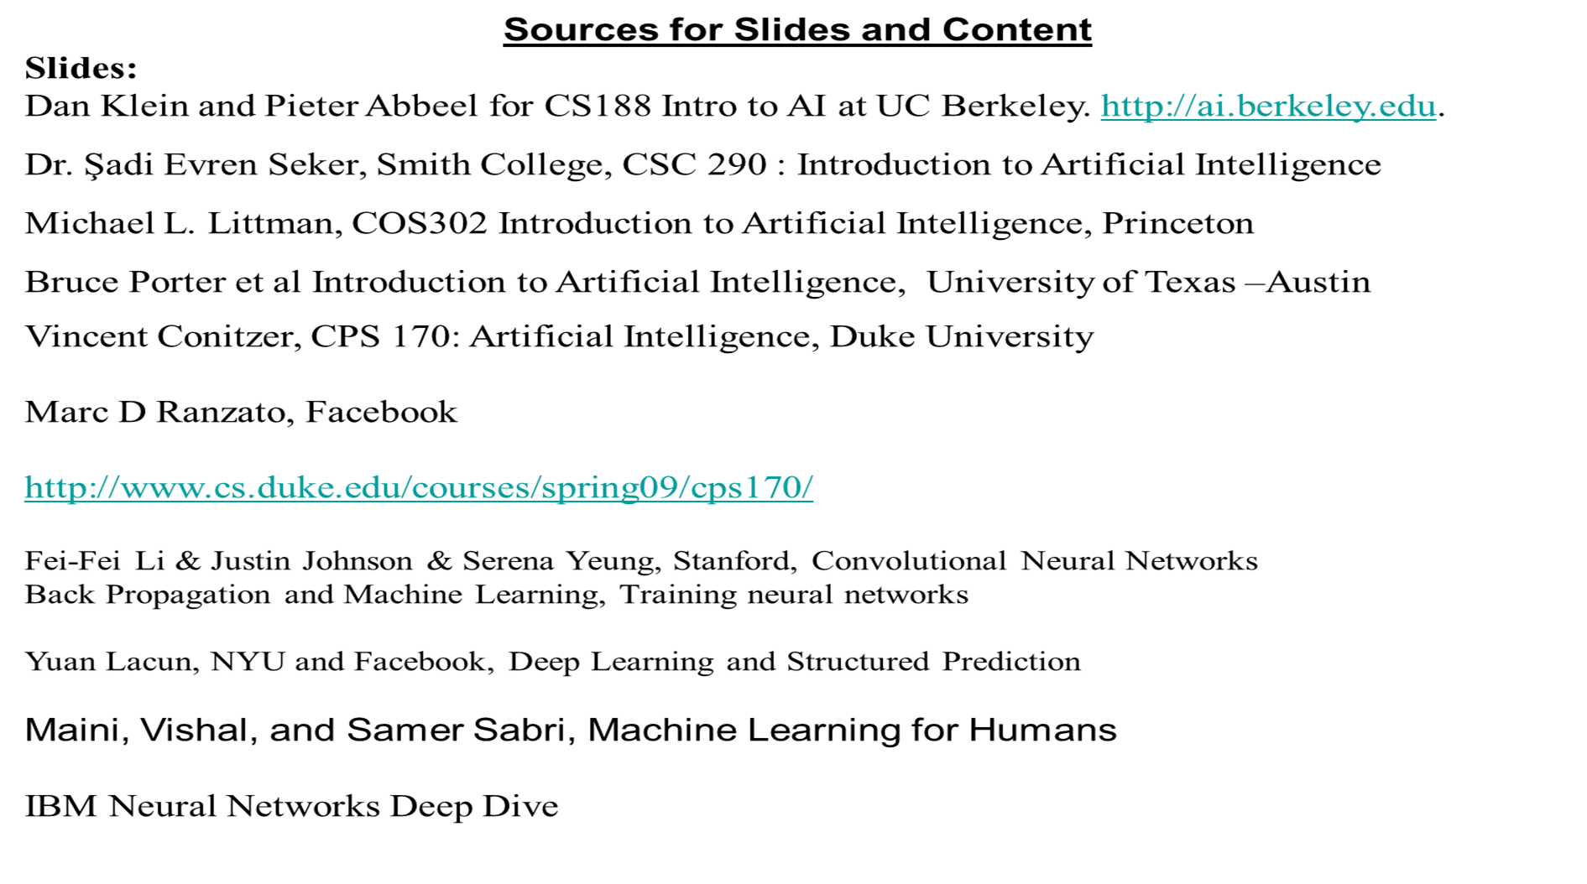
Yann LeCun

Slide 7
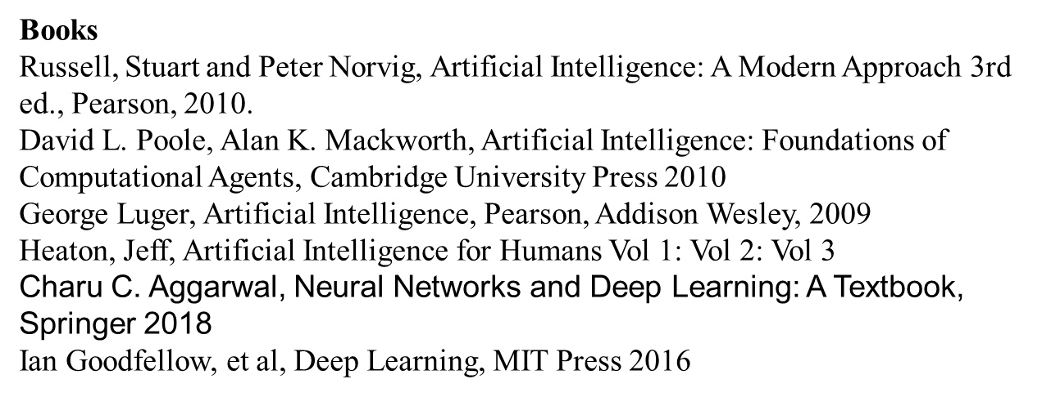

Slide 8
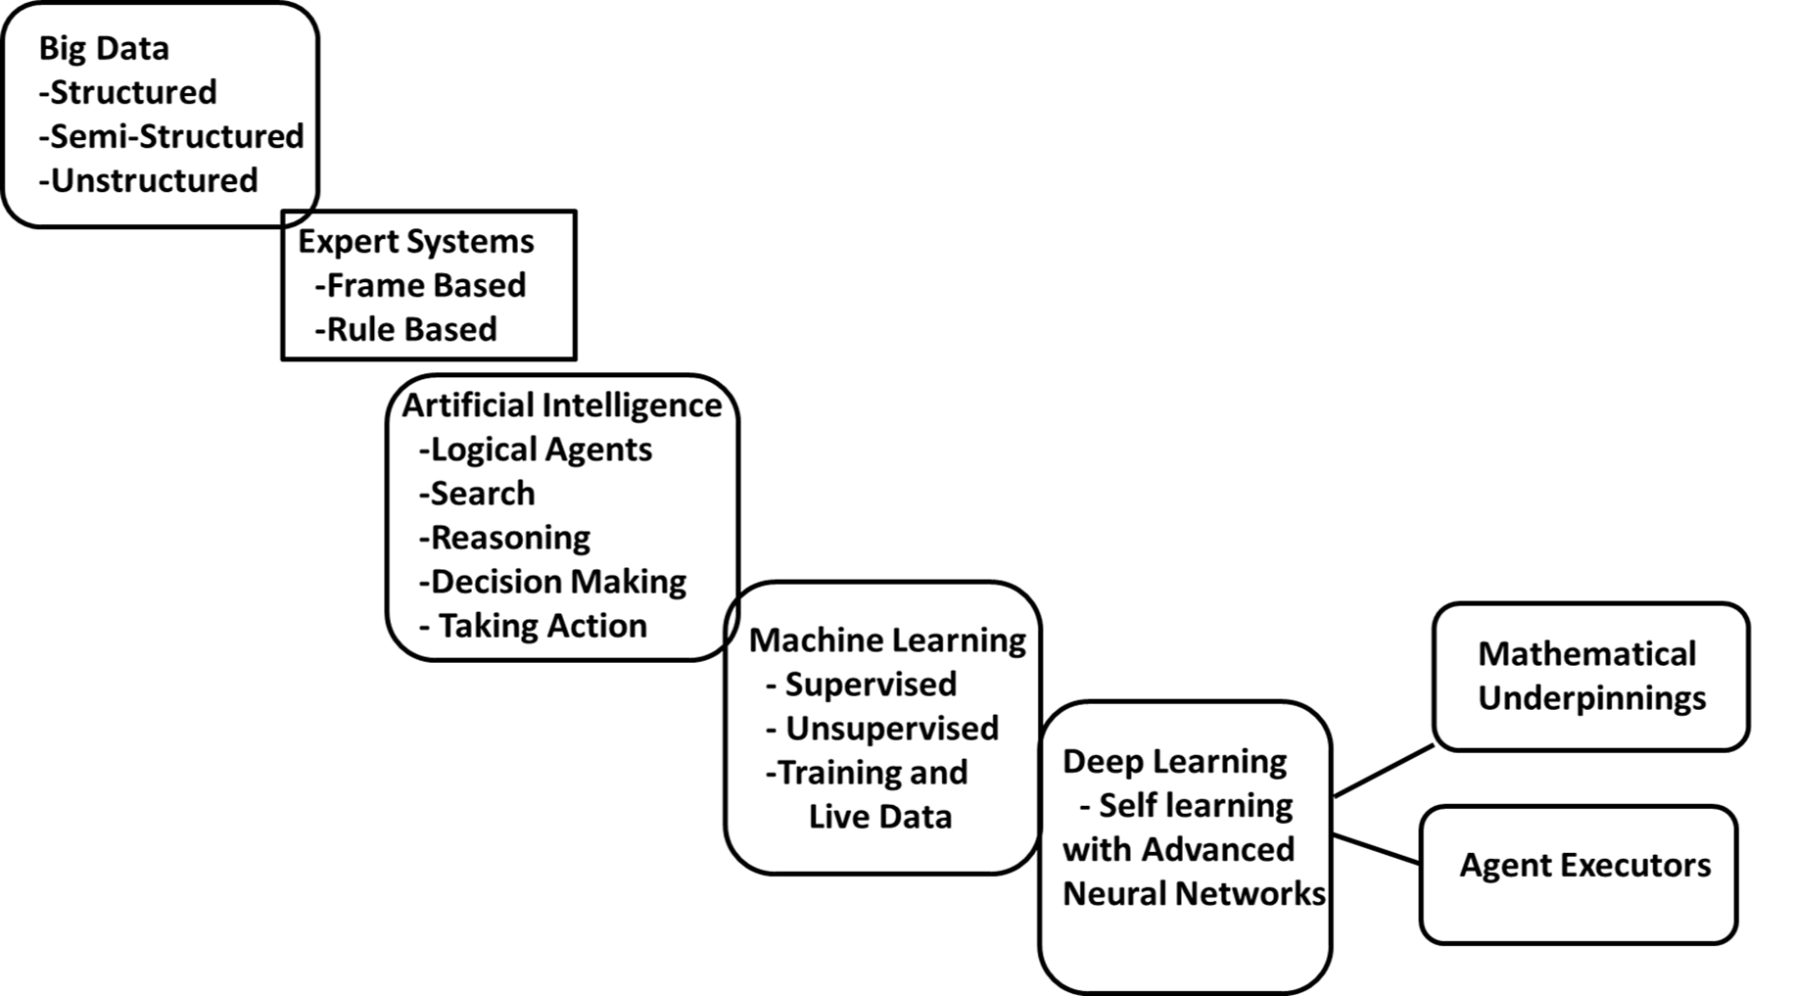

Slide 9
Artificial Intelligence (AWS definition)
Intelligent Behavior by Machines who can scan and observe their environments and take action accordingly.
Machine equipped with AI can solve problems like humans would and eventually achieve the ability to learn and make decisions on their own better than a human can.

Slide 10
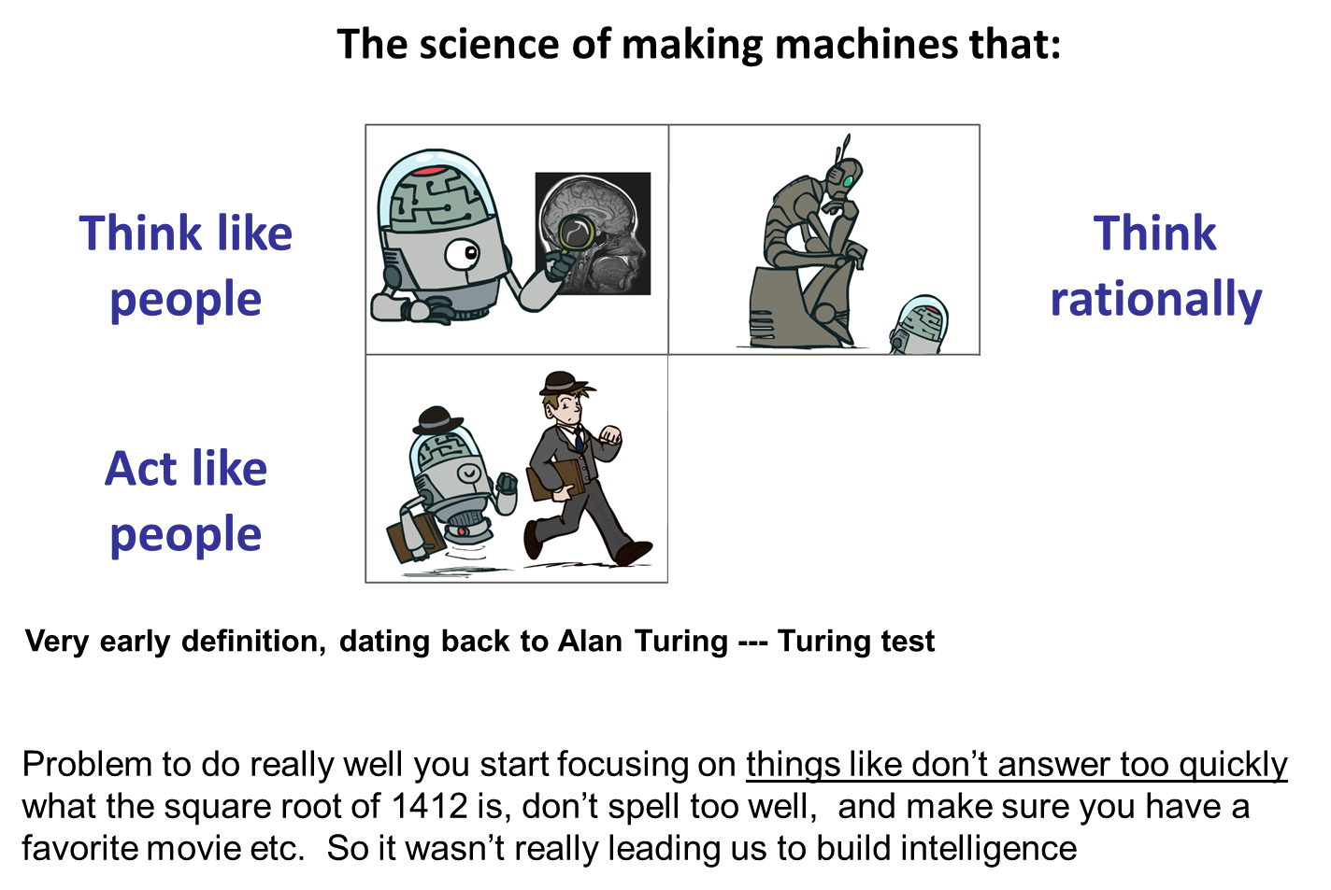

Slide 11
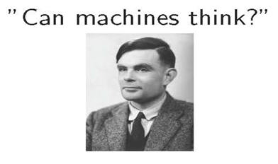
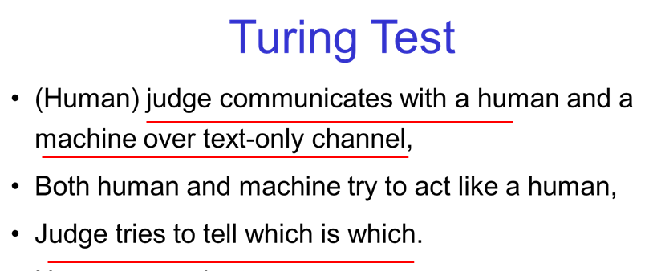
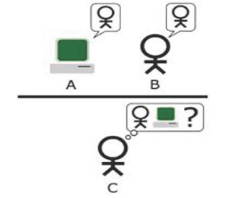
1950

Slide 12
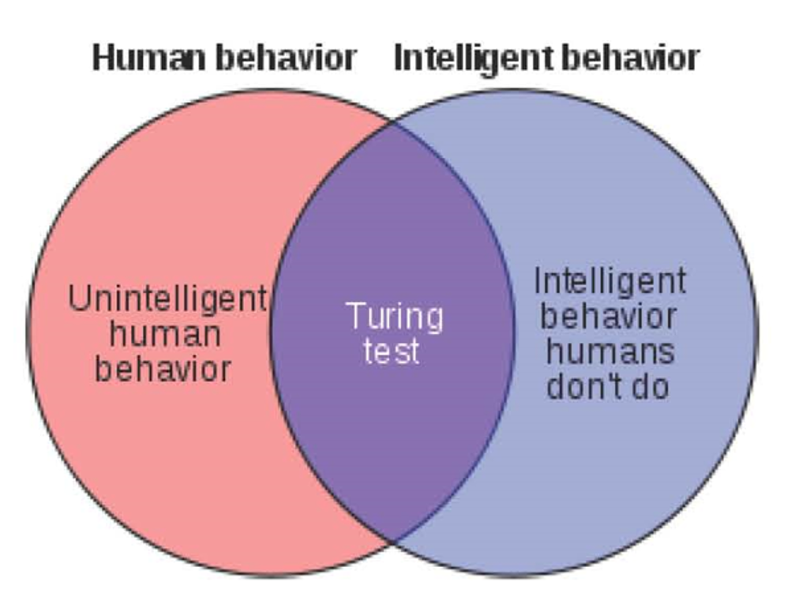

Slide 13
Why AI?
"AI can have two purposes.
One is to use the power of computers to augment human thinking, just as we use motors to augment human or horse power. Robotics and expert systems are major branches of that. T
The other is to use a computer's artificial intelligence to understand how humans think. In a humanoid way. If you test your programs not merely by what they can accomplish, but how they accomplish it, they you're really doing cognitive science; you're using AI to understand the human mind."
- Herb Simon

Slide 14
What Things that People Do Easily
Common sense reasoning
Vision and Decisions Based upon Vision
Moving around/ Manipulating Objects
Language and Interpretation

Slide 15
What Other Things People Do Easily?
If you have a problem, think of a past situation where you solved a similar problem.
If you take an action, anticipate what might happen next.
If you fail at something, imagine how you might have done things differently.
If you observe an event, try to infer what prior event might have caused it.
If you see an object, wonder if anyone owns it.
If someone does something, ask yourself what the person's purpose was in doing that.

Slide 16
How Can We Teach Things to Computers?
In order for a program to be capable of learning something, it must first be capable of being told it.
-John McCarthy

Slide 17
How?
First program an Agent
Then Train it to recognize situations and objects
Then expose it to live situations so that it can learn from reality.

Slide 18

Reasoning
We can describe reasoning as:
A search in a space (Storage) of possible similar (Labeled) situations.

Slide 19
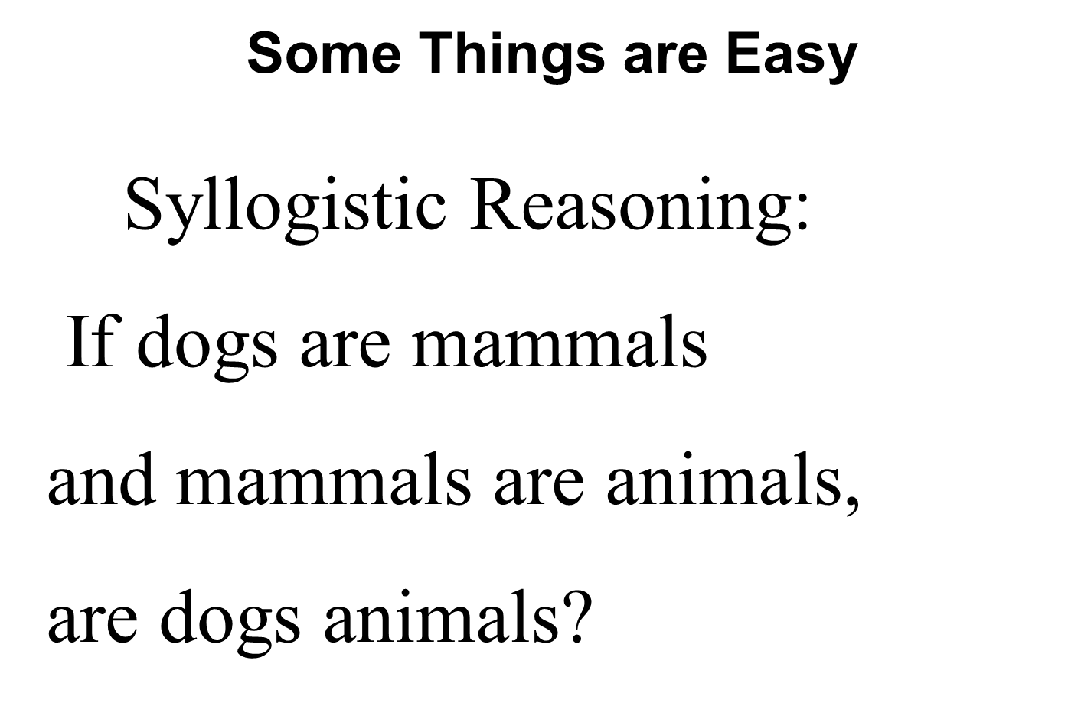

Slide 20
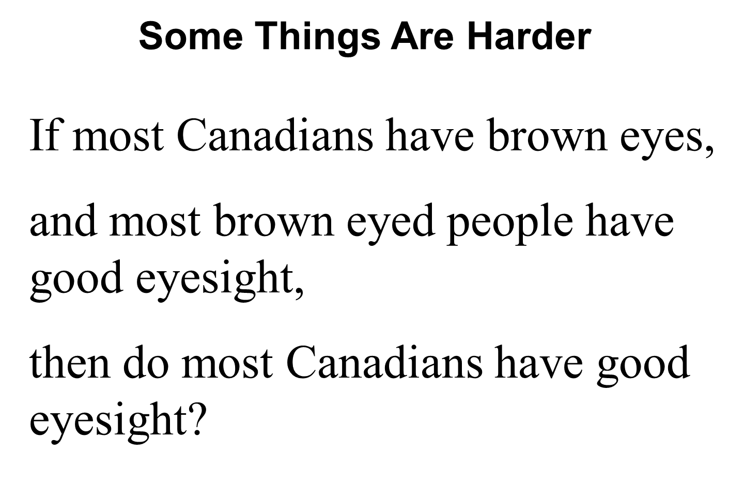

Slide 21

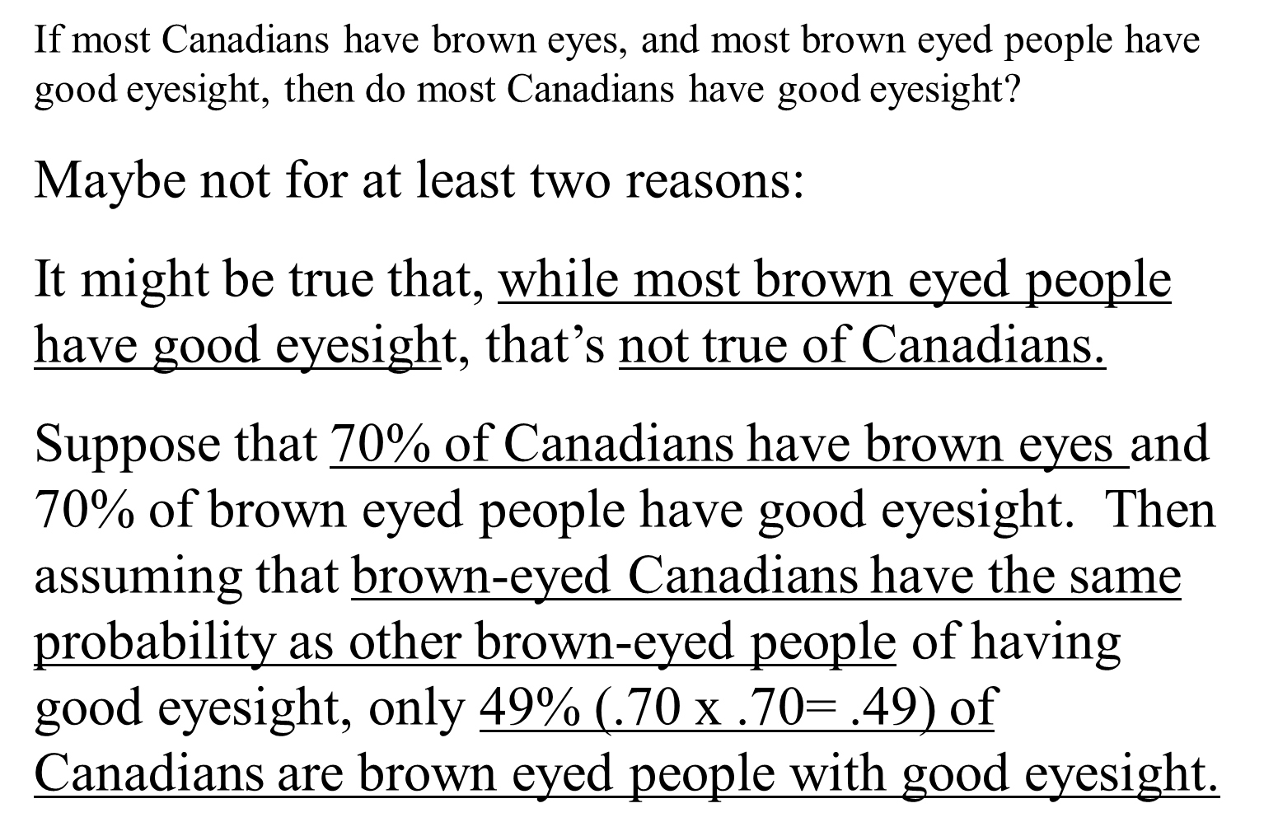

Slide 22
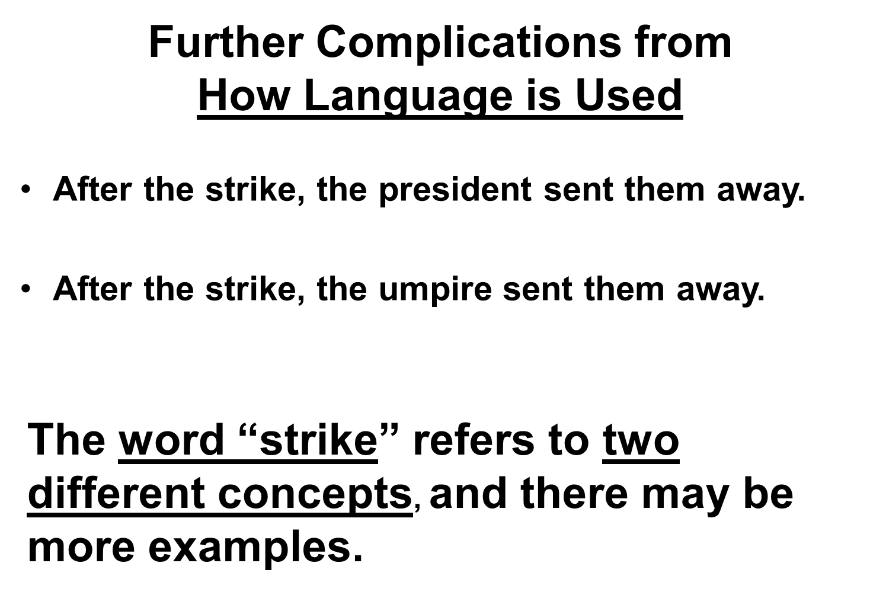

Slide 23
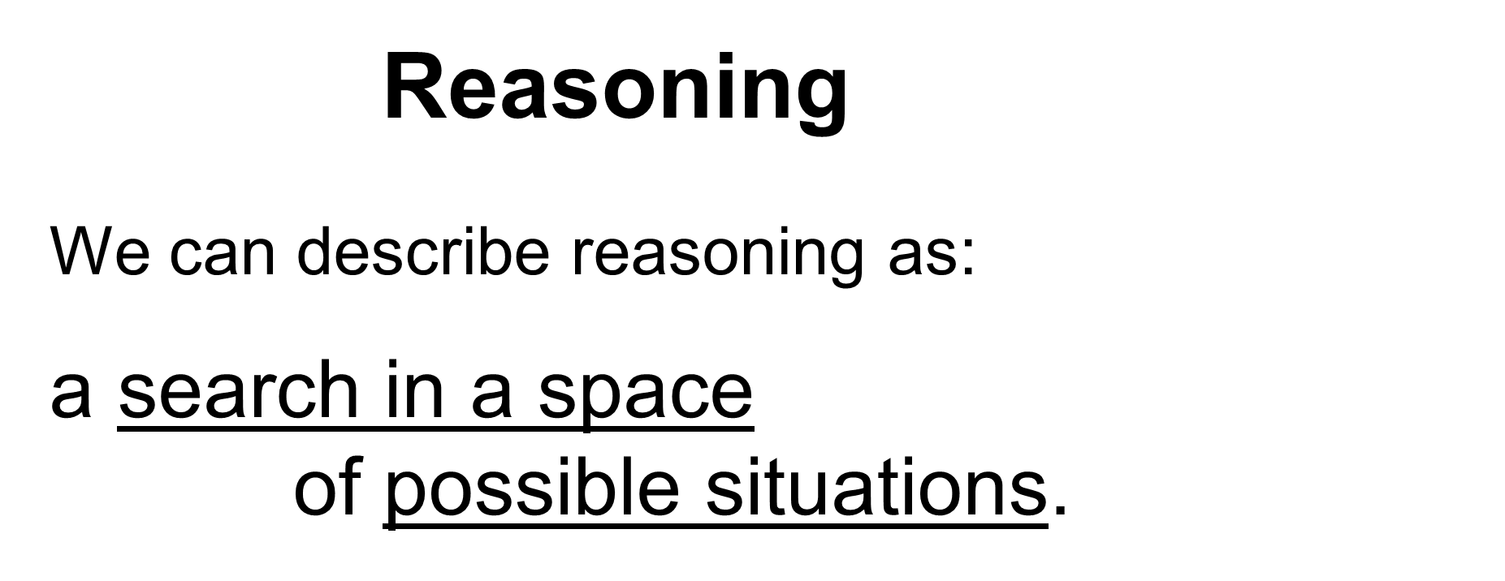

Slide 24
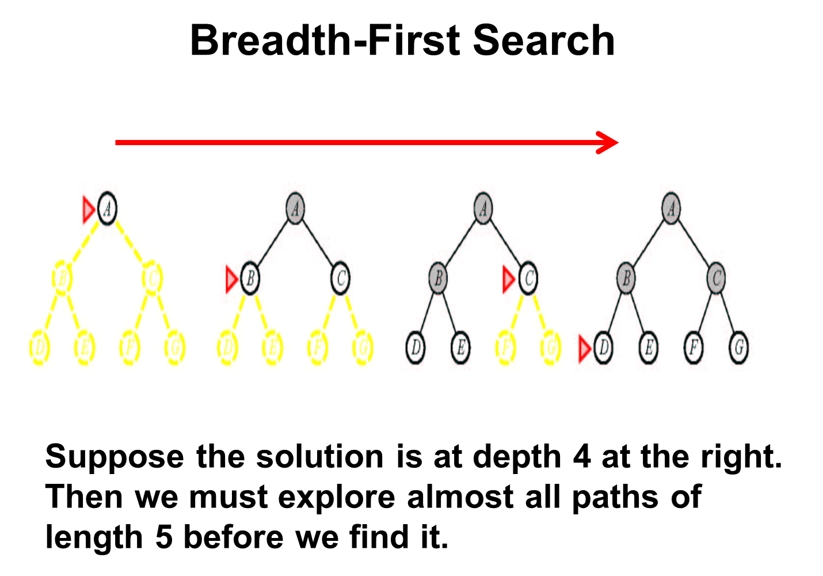

Slide 25
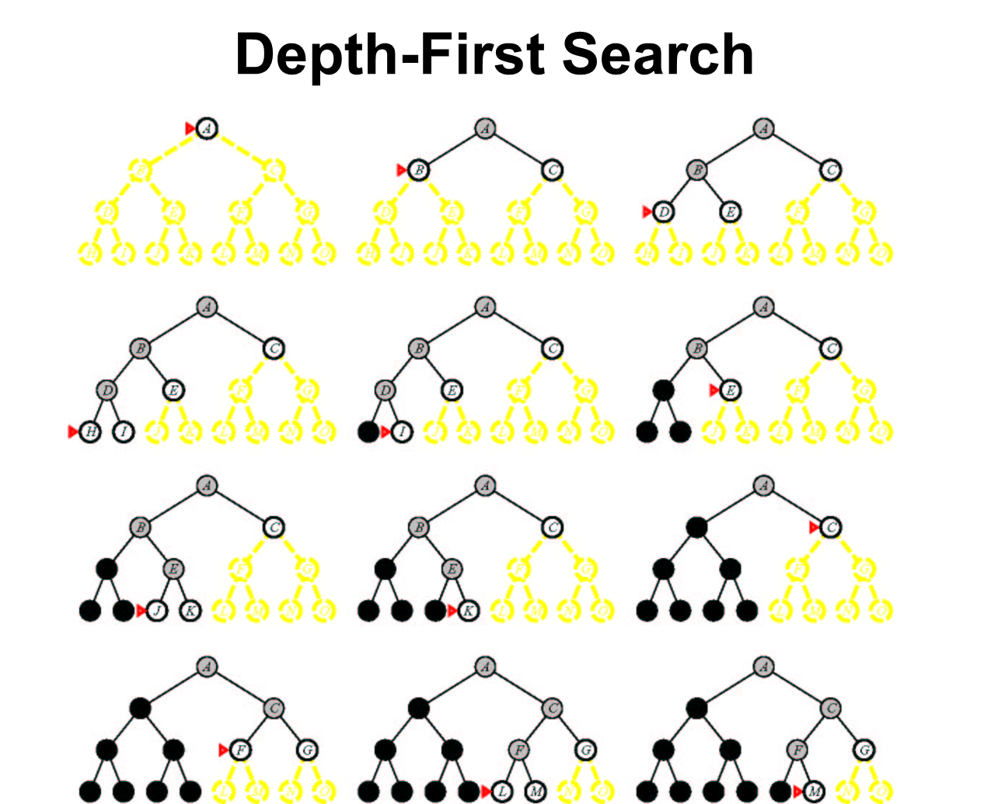

Slide 26
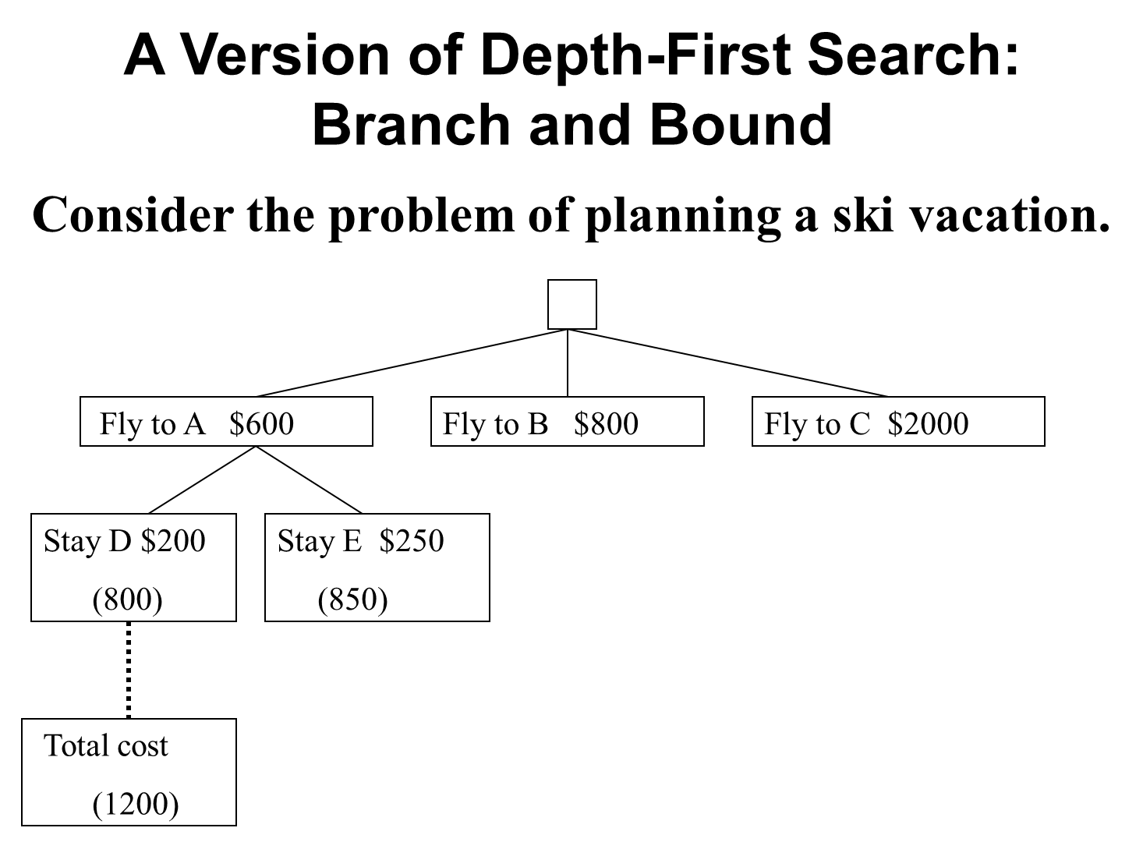

Slide 27
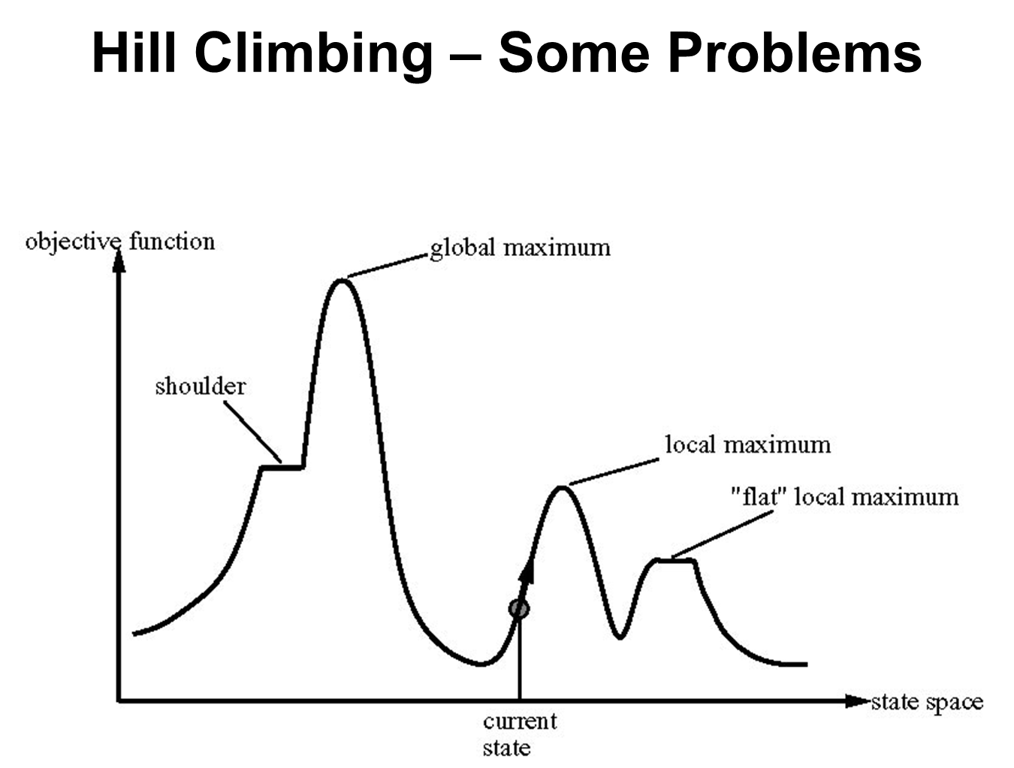

Slide 28
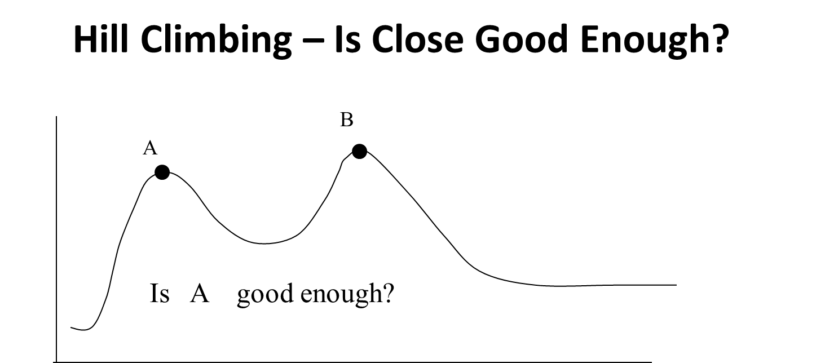

Slide 29
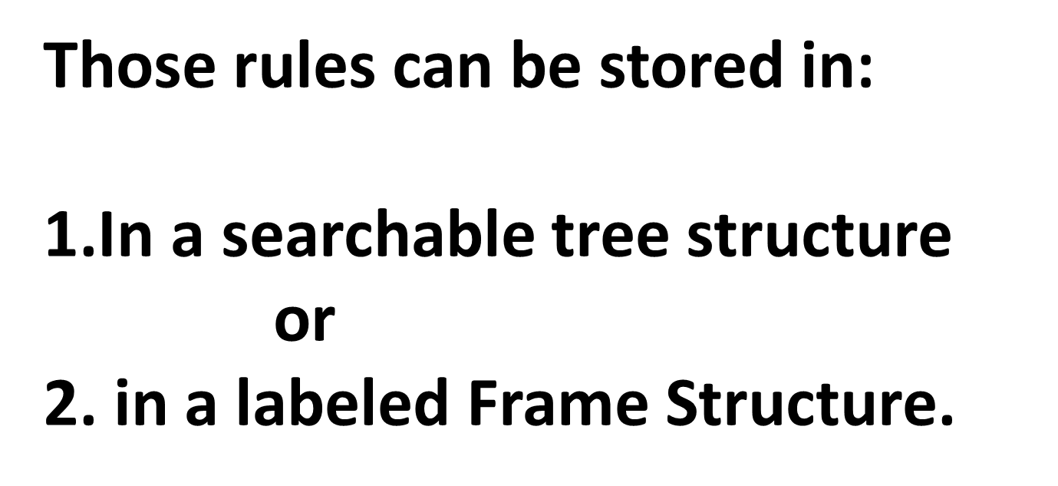

Slide 30
What Can AI Do today?
Quiz: Which of the following can be done at present?
Play a decent game of table tennis? Yes
Play a decent game of Jeopardy? Yes
Drive safely along a curving mountain road? Yes
Drive safely along Telegraph Avenue? Yes but not with me!
Buy a week's worth of groceries on the web? Yes
Buy a week's worth of groceries at Kroger? Yes
Discover and prove a new mathematical theorem? No
Converse successfully with another person for an hour? ?
Perform a surgical operation- on You? Not by itself
Put away the dishes and fold the laundry? Yes
Translate spoken Chinese into spoken English in real time? Yes
Write an intentionally funny story? Maybe

Slide 31
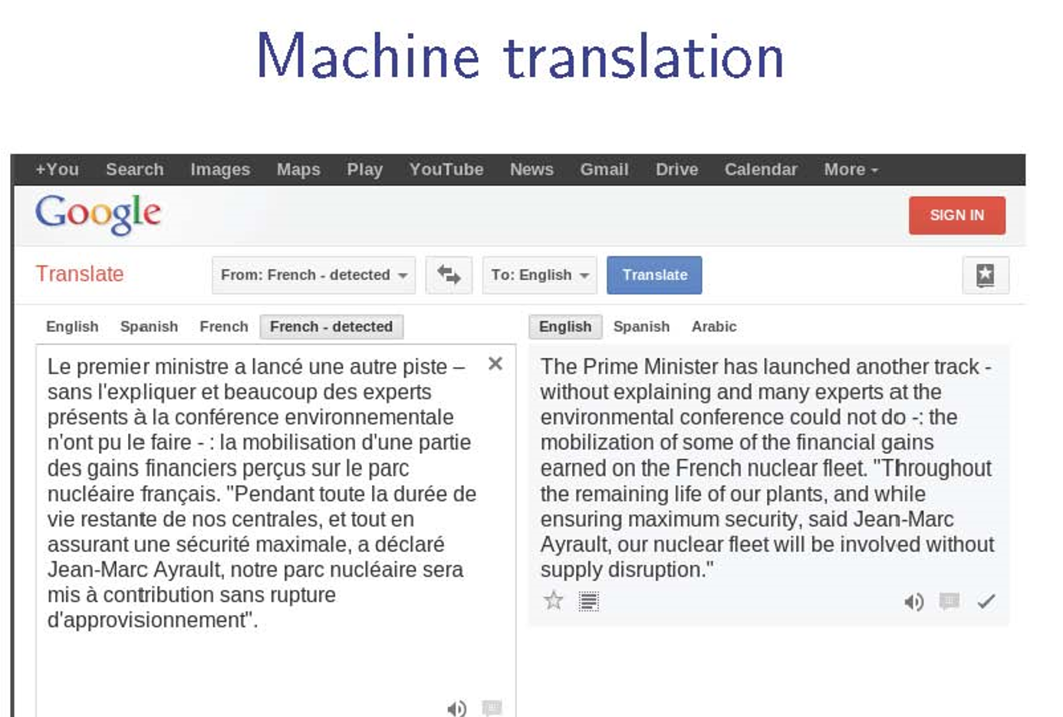

Slide 32
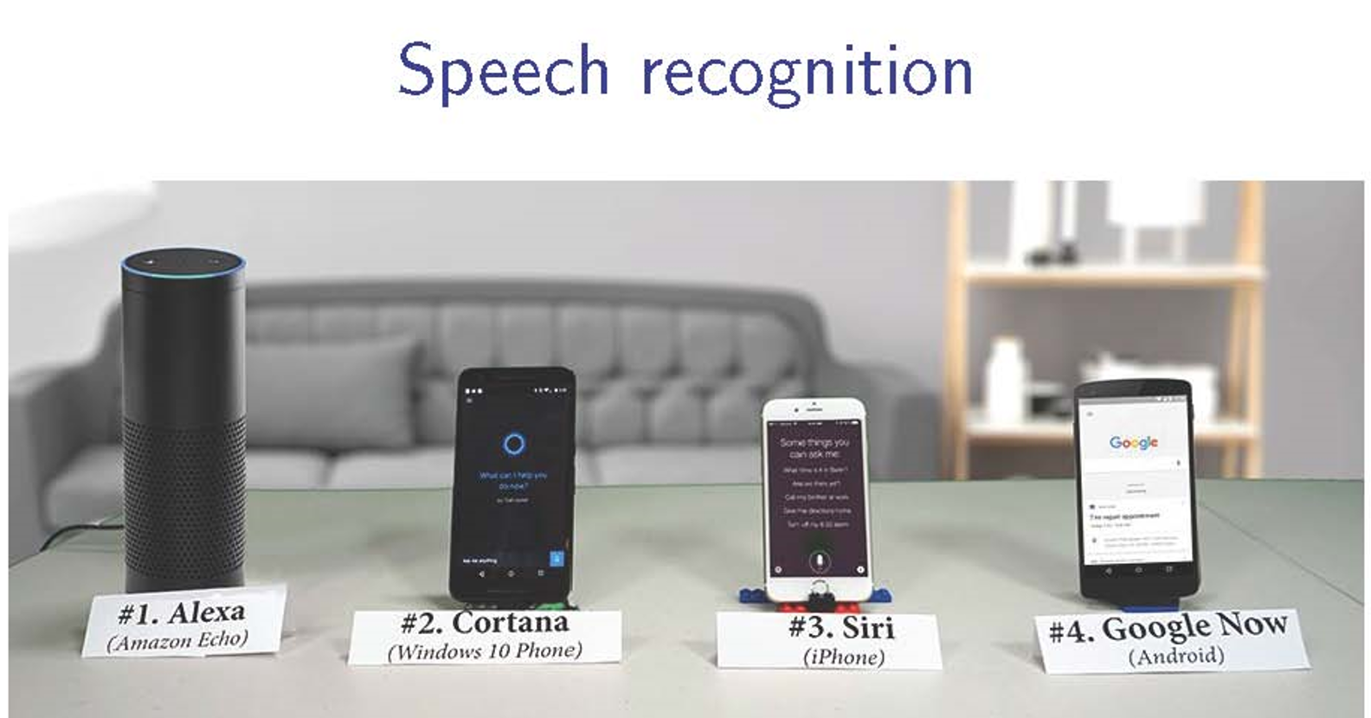

Slide 33
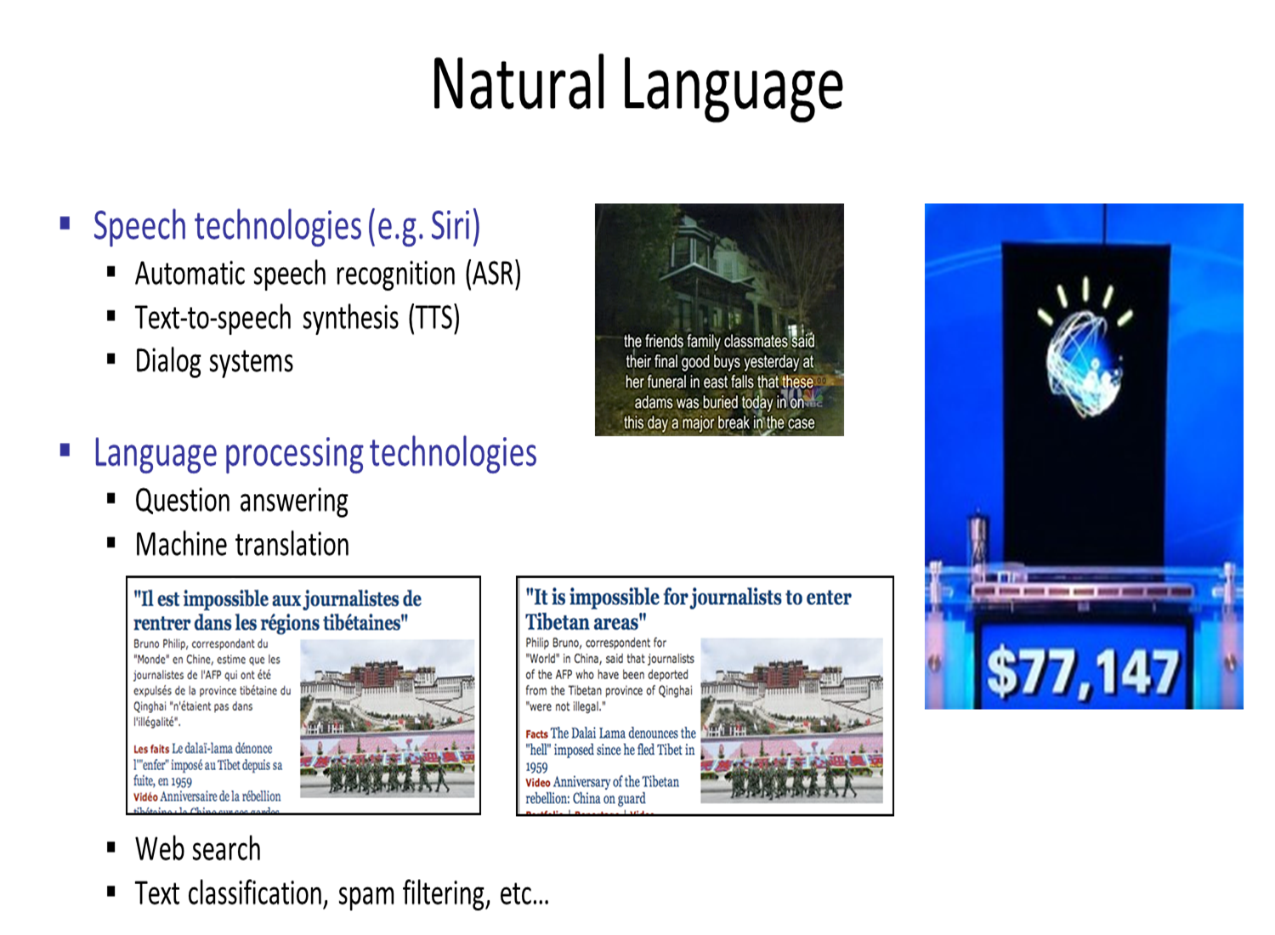

Slide 34
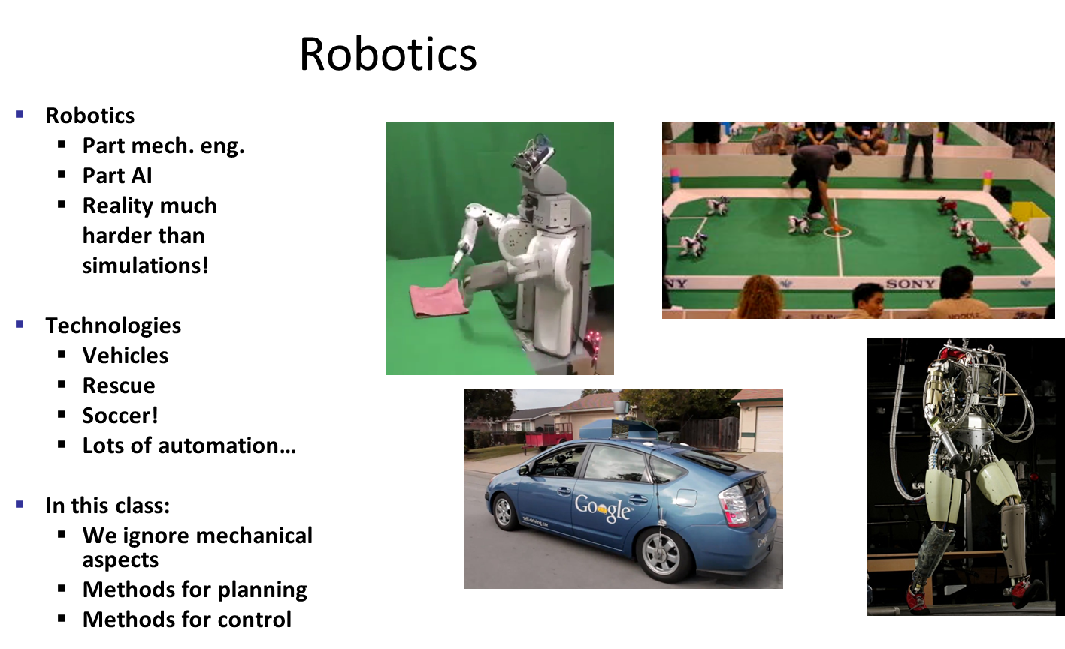

Slide 35
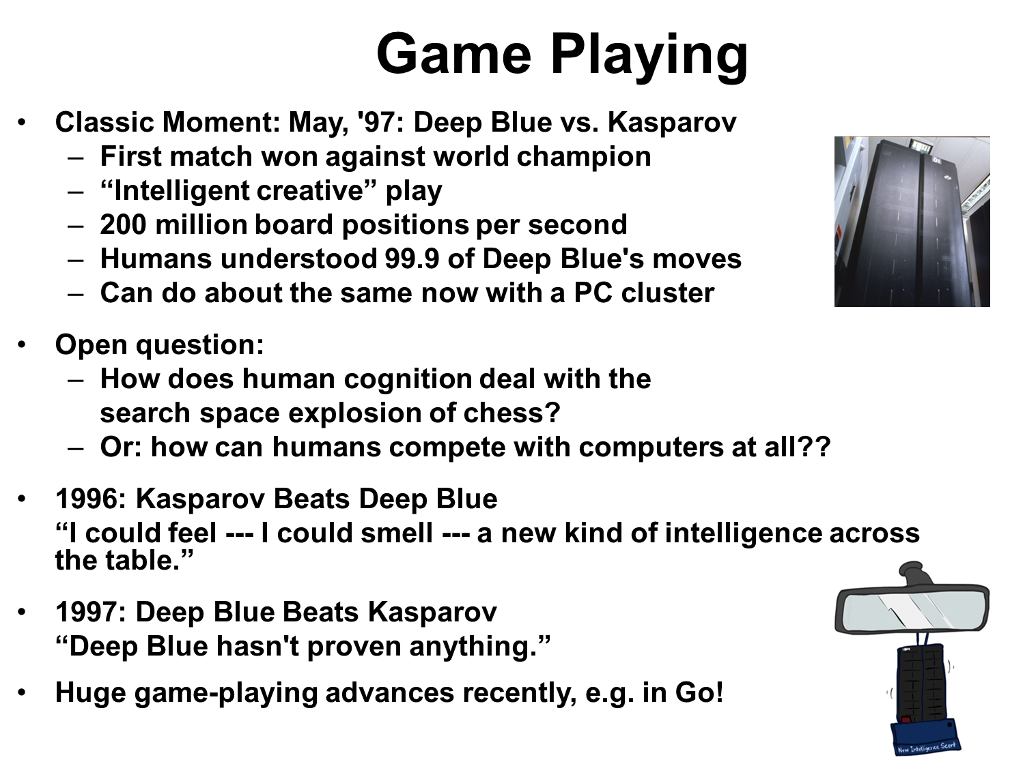
IBM’s Watson- Jeopardy, Google’s AlphaGo

Slide 36
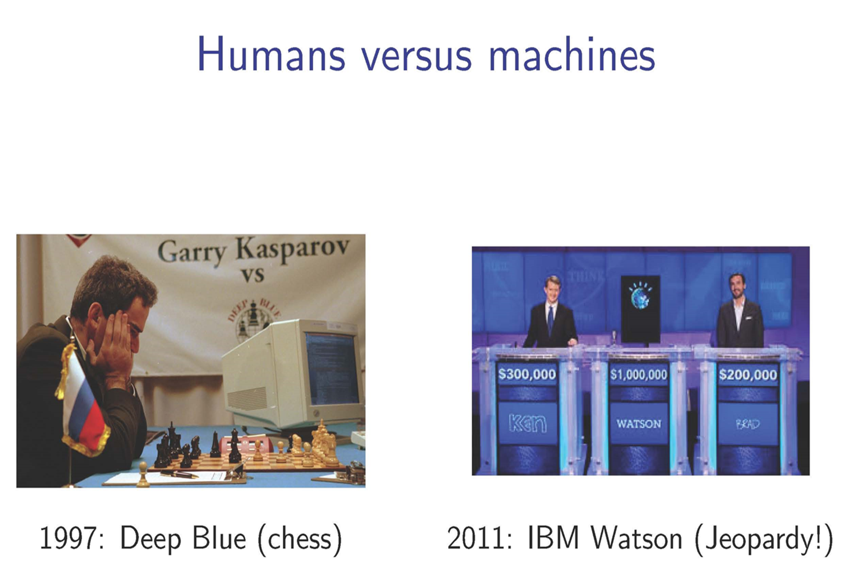

Slide 37
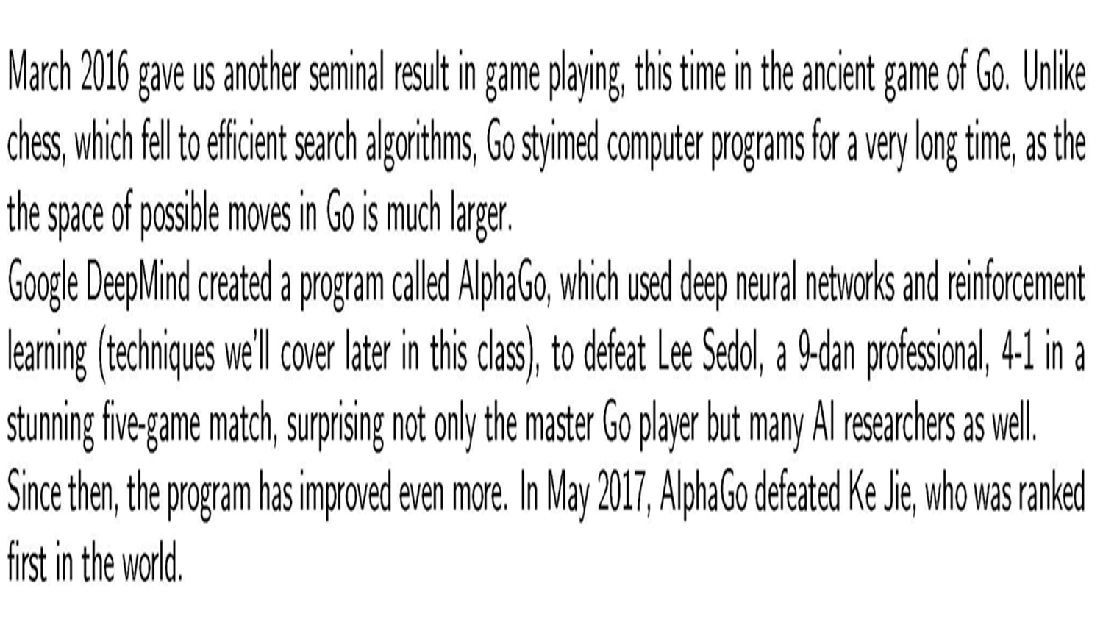

Slide 38

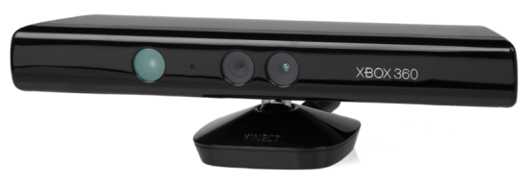
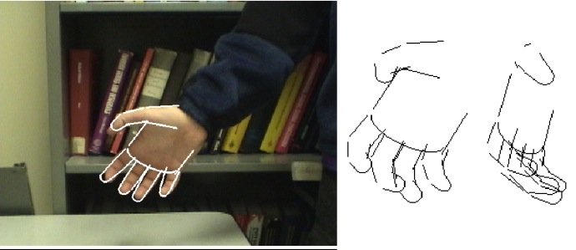
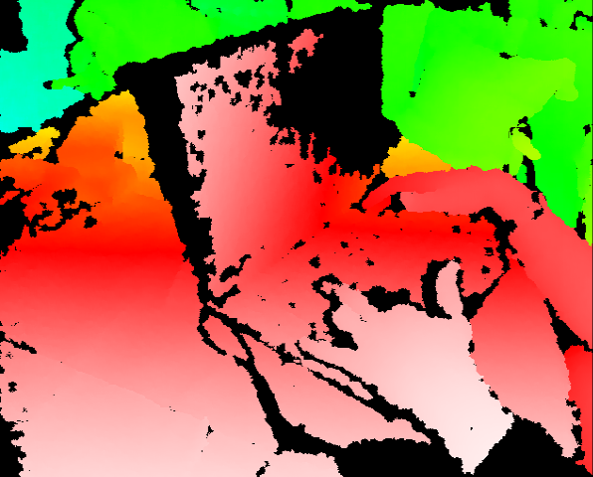
Object and face recognition
Scene segmentation
Image classification

Slide 39
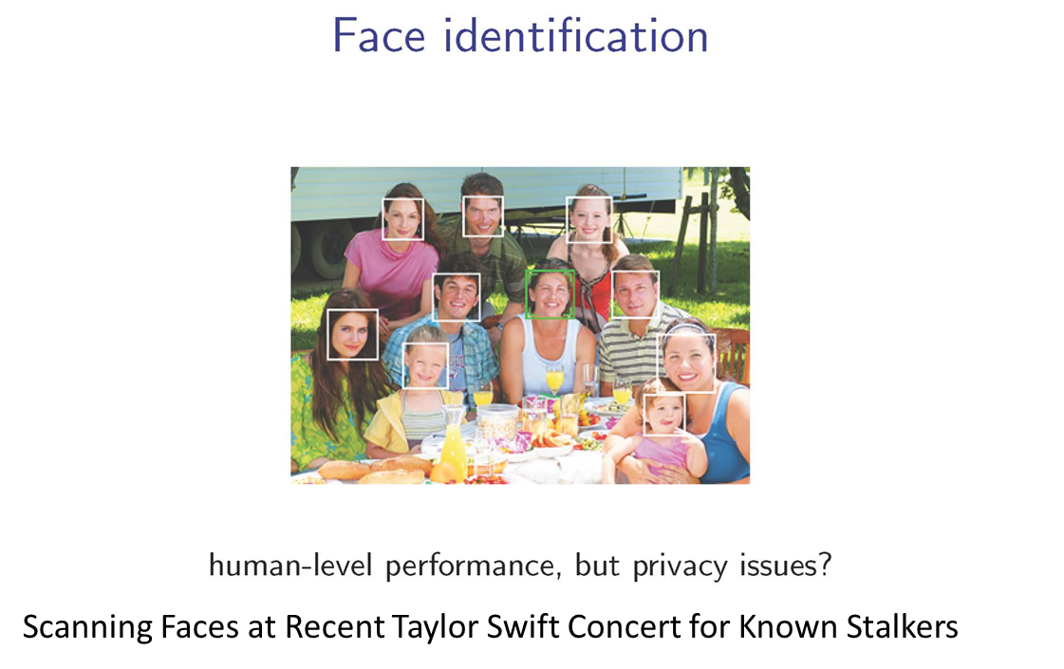

Recent Privacy Example:

Slide 40

NOT TAYLOR SWIFT”S STALKER!

Slide 41
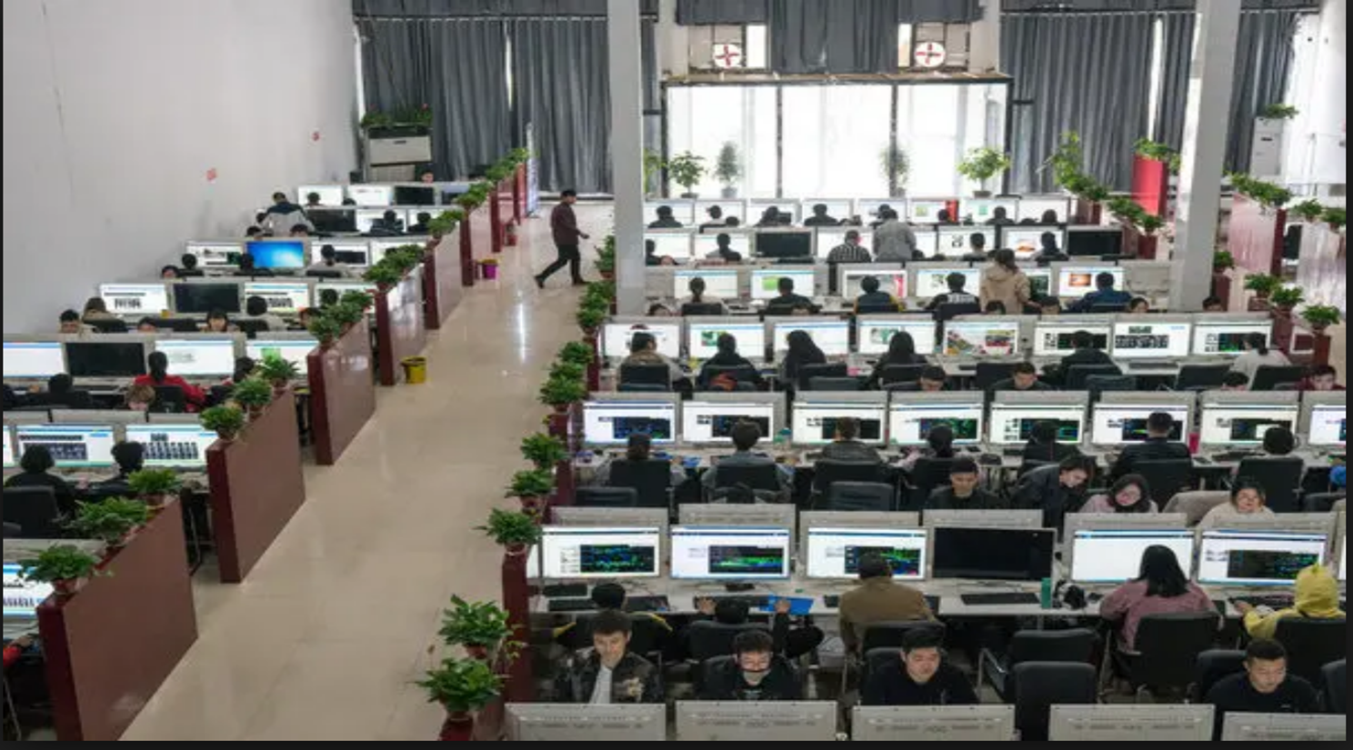
2018 China Image Labeling Factories

Slide 42
Image Recognition
with
Convolutional Neural Networks

Slide 43


Slide 44
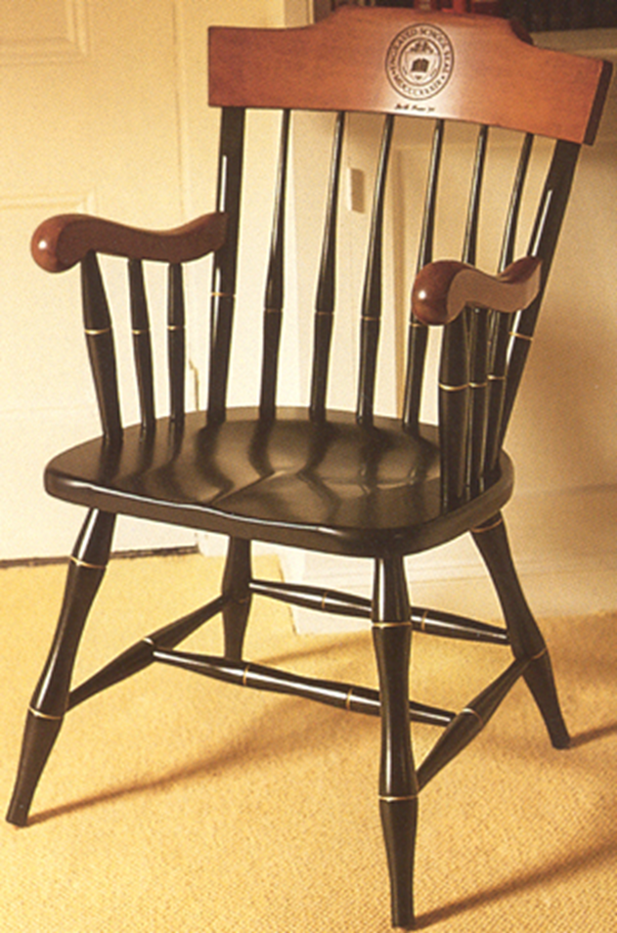


Slide 45


Slide 46
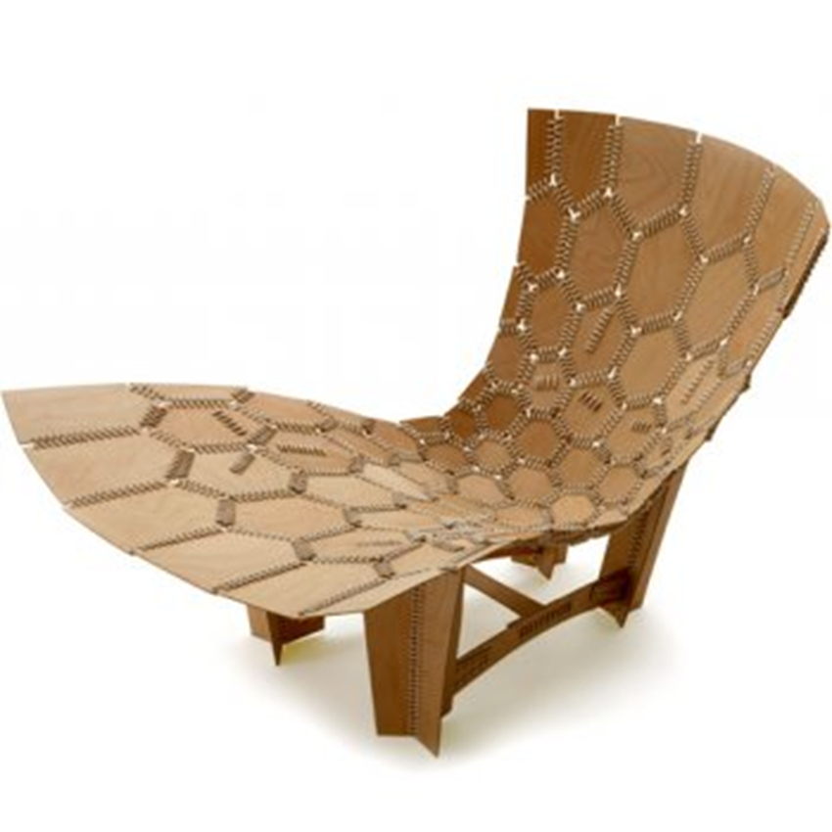

Slide 47


Is it a Dog or a Cat?

Slide 48
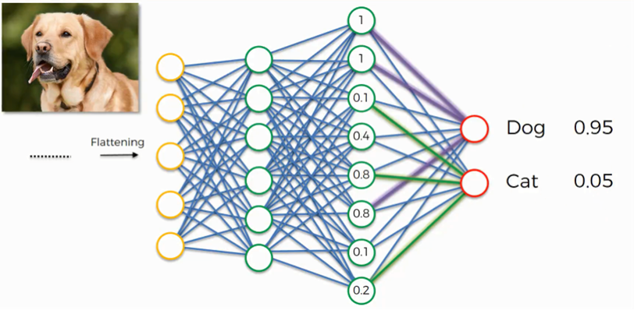

Correct Categorization and Labeling

Slide 49
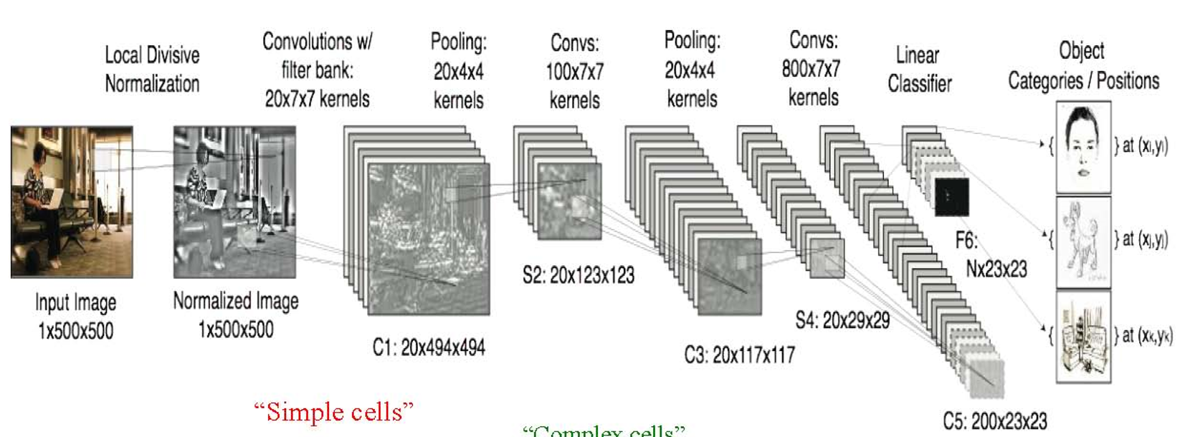
Convolutional Neural Networking – Correct Categorizing Images and Labeling Them
Correct Categorization and Labeling the Outputs
Linear Classification
Normalize the Data
Pool the Data
Pool the Data
Label
the Output

Slide 50
Some Components of Artificial Intelligence
1. Knowledge Representation and Storage
Objects, Frames, Rules and Trees 2. Finding Appropriate Data 3. Searching for Stored Knowledge Fast Search / Planning
Constraint Satisfaction
Informed Search
Uninformed Search
Heuristic Search
Adversarial and Uncertain Search- Games
4. Reasoning under Uncertainty
Natural Language Processing, Machine Learning, Deep Learning, Bayes’ Nets, Neural Nets, Training Data Sets
5. Making Decisions under Uncertainty 6. Some Applications
Business Decision Making, Pattern Recognition, Natural Language, Vision, Robotics, Games

Slide 51
Storing and Accessing Knowledge
If you can’t Store Knowledge,
or If you can’t Find it after Storing it,
Knowledge is Useless.

Slide 52
Knowledge Representation and Organization
Records
Objects/Blobs/Buckets
Rules
Trees
Frames
Tables
Index with Pointers

Slide 53
STRUCTURE OF FRAMES
FRAME
FRAME NAME
Header
Portion
PARENT
PARENT NAME
ATTRIBUTE 1
ATTRIBUTE 1 VALUE
Attribute
ATTRIBUTE 2
Portion
ATTRIBUTE 1 VALUE
ATTRIBUTE 3
ATTRIBUTE 1 VALUE
ATTRIBUTE 4
ATTRIBUTE 1 VALUE
ATTRIBUTE 5
ATTRIBUTE 1 VALUE
ATTRIBUTE 6
ATTRIBUTE 1 VALUE
Behavior
If A equals B
Portion
and C equals D
Routine H Pointer
Then Do E
and Do F
End

Slide 54
Frame plus Branch to a set of Subroutines
STRUCTURE OF FRAMES
FRAME
FRAME NAME
Header
PARENT NAME
Portion
PARENT
ATTRIBUTE 1
ATTRIBUTE 1 VALUE
Attribute
ATTRIBUTE 2
ATTRIBUTE 1 VALUE
Portion
ATTRIBUTE 3
ATTRIBUTE 1 VALUE
ATTRIBUTE 4
ATTRIBUTE 1 VALUE
ATTRIBUTE 5
ATTRIBUTE 1 VALUE
ATTRIBUTE 6
ATTRIBUTE 1 VALUE
If A equals B
SUBROUTINE H
Behavior
and C equals D
Routine H Pointer
Portion
Then Do E
and Do F
Procedure 1
End
Procedure 2
If W equals X
and Y equals Z
Do Procedure 3
else Do Procedure 4
End if
Procedure 3
Procedure 4
End Subroutine
Return

Slide 55
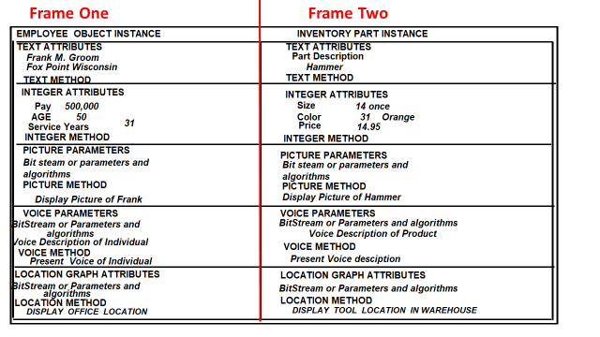

Slide 56
A Tree Structure for Storing and Accessing a Set of Rules
RULE STRUCTURE
Initial Qualifying Test
If.....
And If....
Then Go To String A
Else Go to String B
String A
String B
Secondary Qualifying Test
Secondary Qualifying Test
If.....
If.....
And If....
And If....
Then Go To String A1
Then Go To String B1
Else Go to String A2
Else Go to String B2
String A1
String A2
String B1
String B2
Execution Qualifying Test
Execution Qualifying Test
If.....
If.....
And If....
And If....
Then Perfom Routine A1A
Then Perfrom B2A
Else Perfrom Routine A1B
Else Perform B2B

Slide 57
RULE STORAGE STRUCTURE
INITIAL TEST CODE
Initial Qualifying TestIf.....And If...Then Go To String A Else Go to String B
String A
Secondary Qualifying Test If.....And If... Then Go To String A1 Else Go to
String A2
String A1
Execution Qualifying Test If.....And If....Then Perfom Routine A1A
Else Perfrom Routine A1B
String A2
Execution Qualifying Test If.....And If....Then Perfom Routine A1A
Else Perfrom Routine A1B
String B
Secondary Qualifying Test If.....And If... Then Go To String A1 Else Go to
String A2
String B1
Execution Qualifying Test If.....And If....Then Perfom Routine A1A
Else Perfrom Routine A1B
String B2
Execution Qualifying Test If.....And If....Then Perfom Routine A1A
Else Perfrom Routine A1B

Slide 58
Index with Pointers to Knowledge

Slide 59
Three Modern Approaches for Data Management And File Access
1. Block Level Access
2. File Level Access
3. Object Level Access

Slide 60
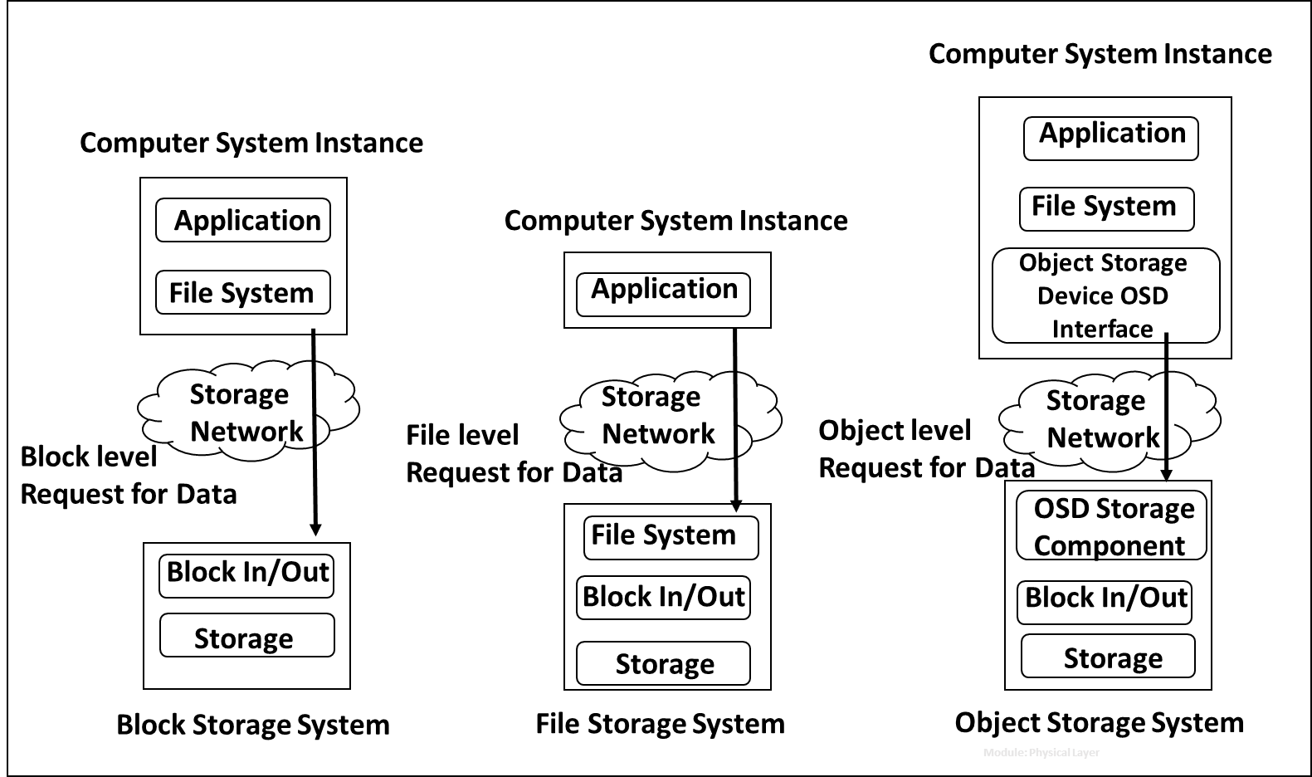
Three Basic File (Information) Access Approaches
Browser
Web Server
Amazon AWS S3

Slide 61
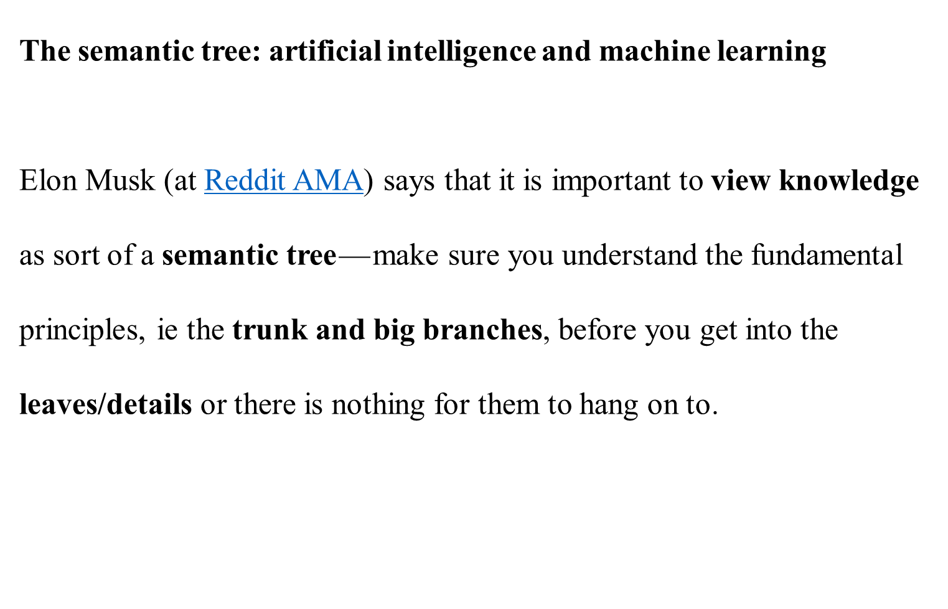

Slide 62
Searching for Desired Data
Following Elon Musk’s Tree Structure of
Stored Knowledge

Slide 63

A Basic Tree Structure Of Knowledge

Slide 64
Pruning Search Trees
Search tree analysis can be applied to much more complicated games such as chess.
However, full analysis of the chess search tree would take more than your lifetime to determine the first move.
Because these trees are so large, only a fraction of the tree can be analyzed in a reasonable time limit, even with modern computing power.
Therefore, we must find a way to prune the tree.

Slide 65
Techniques for “Pruning” Search Space
1. Depth-first Search
A technique that involves the analysis of selected paths all the way down the tree
2. Breadth-first Search
A technique that involves the analysis of all possible paths but only for a short distance down the tree

Slide 66
Search Tree Strategies
Breadth-first strategies tend to be more successful (and computationally feasible).
Search tree analysis can be applied nicely to other, more complicated games such as chess.
In 1997, IBM’s Deep Blue became the first program to defeat a master-level chess player following a Breadth First approach to quickly prune the Knowledge Tree.

Slide 67

Look for First “Reasonably Good” Solution

Slide 68

Exhaustive Search until First Reasonably Good Solution

Slide 69

Both

Slide 70

Algorithm

Slide 71
Informed Searches take advantage of information available beyond that contained in the definition of the problem itself.
The Best-First algorithm is a practical method, not guaranteed to be either optimal, perfect, logical, or rational, but still is sufficient for achieving an immediate goal.
3. Searching with a heuristic algorithm might include an “estimated” cost contained as an element in each of the bottom leaf nodes. Select the first one encountered which meets an estimated lowest cost.

Slide 72
Other Search Strategies
1. Sophisticated Search
2. Branch and Bound
3. Heuristics Search
4. Dynamic Programming
a. We heuristically decide to simplify the number of nodes available
b. use information from previous searches

Slide 73
Branch and Bound Search combines
1. the depth-first simple strategy, which tends to end up with an optimal solution eventually, with
2. a heuristic search approach- most frequently using an A* technique which tends to reduce the number of search nodes and thus the cost.

Slide 74
Agents- Perform AI Actions
1. Intelligent Agents
2. Learning Agents
3. Logical Agents

Slide 75


Slide 76

The Agent Program Runs on the Intelligent Component, Observes and Reacts to the Environment, Executes a Function (f: P* A) as an Action when Required.

Slide 77
Rational Agents
A Rational Agent is one which performs the Right Action appropriate to the sensed Conditions in the Environment and which Leads to a Successful Outcome appropriate for the situation.

Slide 78
Agent types
Four basic types in order of increasing generality:
1. Simple reflex agents
2. Model-based reflex agents
3. Goal-based agents
4. Utility-based agents

Slide 79

Sense the Environment
1
Quick Look up for Correct Action
2
Access the Action Rule
3
Deploy the Action Rule

Slide 80



1
2
Compare the Environment Condition to Action Model
3
Look Up the Appropriate Action for the Condition
4

Slide 81

Sense the Environment
1
2
Compare the Environment Condition to Goal Model
3
Look up Appropriate Action for the Chosen Goal
4
Deploy the Action Rule

Slide 82

Sense the Environment
2
1
Learn What Actions Meet the Conditions of the Current Environment
3
4
5
Deploy the Action Rule

Slide 83
Reasoning

Slide 84
Reasoning with Full Knowledge-
Reasoning with Partial
Reacting to Thresholds

Slide 85
Agents Employing Reasoning and Making Decisions
An Agent is a software driven device that
perceives its environment,
2. senses changes in that environment through components called Sensors,
3. analyzes the sensed data for which it is programmed to react, and then
4. reacts to what it has sensed by means of actuators which are used by the device to take action.

Slide 86
The agent may be:
A software programmed device which responds to the sensing,
a robotic component which takes mechanical or electronic action, or
a communicator, transmitting packets of information as a response to what is sensed in the environment.
In all cases, the agent’s function and reaction are implemented by a software program

Slide 87
Problem Solving with Found Information

Slide 88


Slide 89
Deterministic
Trained and Learning
Artificial Intelligence
Machine Learning
Training Data
AI Algorithms
ML Algorithms
Linear Algebra
Analytic Geometry
Vector Calculus
Probability- Monte Carlo
Bayesian Probability
Regression
Dimension Reduction
Principle Components Analysis
Cluster Analysis
Partition Analysis
Classification with Vector Analysis
Representation Analysis
Depth Separation
Dimension Reduction
Approximate Inferencing
Autoencoding
Deep Net Analysis
Hierarchical Modeling
Deep Tree Searching Models
Deep Freeforward Nets
Convolutional Nets
Regularization and Optimization

Slide 90


Slide 91


Slide 92


Slide 93


Slide 94


Slide 95


